Slide 1
Python Programming Tutorial
Please logon to the computer and pull up Canopy.

Slide 2
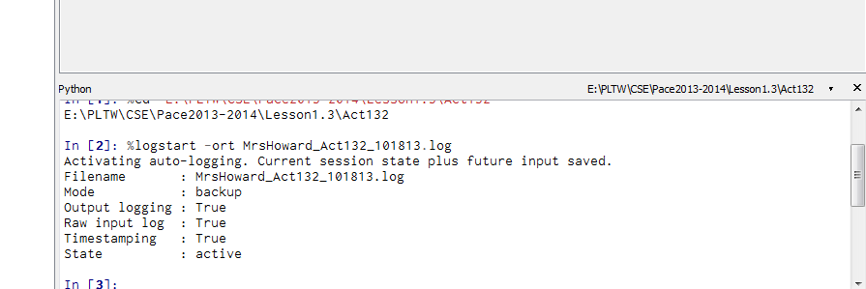
Enthought Canopy Python Environment
How to start class while we’re working in Python:
Open Canopy & start and Editor session.
Change the working directory to your MyDocuments\CSE folder.
Turn on session logging by typing this command in the iPython window:
In []: %logstart -ort YourName_1_3_2_mmddyy.log
Beware: the log is saved only later when you use the command: %logstop
4. Place a title in the logfile using a comment. In Python, the # symbol comments out the rest of the line. Since nothing is executed in a comment, iPython will offer a continuation line. Just press enter.
In []: # YourName Activity_xxx.log
...: (press enter here to end the continued input)

Slide 3
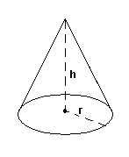
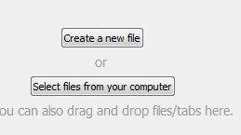
Creating a simple procedure:
Let’s create a procedure to calculate the volume of a right circular cone:

Slide 4


Creating a simple procedure:
Let’s think of a name, understand what we need to “pass” to our program and then define our procedure:
Line 2 should always be a comment
Just as SCRATCH and AppInventor grouped code in blocks, Python uses indentation to group code. Always use 4 spaces for each level of indentation.

Slide 5
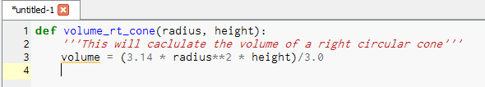
Creating a simple procedure:
Now let’s create a line to do the math for us:
Notice to do a POWER in Python you use **. For example 3² = 3**2
To do a square root, you would raise the base to a power of **.5

Slide 6
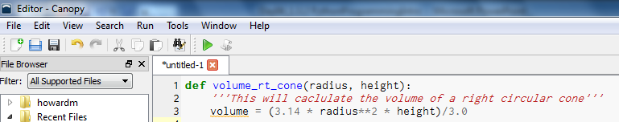

Creating a simple procedure:
Let’s check our work to see if we have any errors yet. Click on the green arrow.
If there are no errors, you’ll see this in the iPython window:

Slide 7
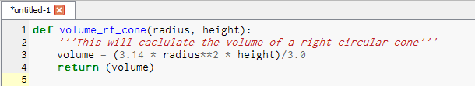
Creating a simple procedure:
The last step is to tell our program to tell us something. So we’ll add our last line to return the value the program calculated
Click the green arrow to compile. Did you get any errors?

Slide 8

Creating a simple procedure:
You just created a new command that Python understands called: volume_rt_cone
When you run the program, it expects you to pass it two numbers – radius & height. In the iPython session type:

Slide 9
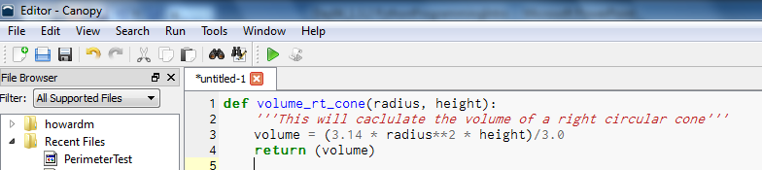
Saving your program
To save your new program, click on File-Save or the disk icon in the Editor window
Save your file to your CSE work directory, be sure you end your filename with .py
Volume_rt_cone.py

Slide 10
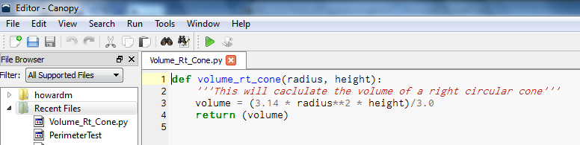
Saving your program
You should see the program in your recent flies list.

Slide 11
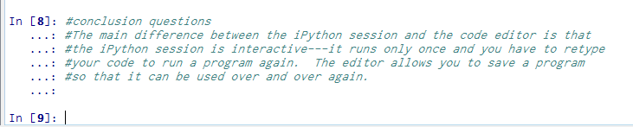
Answering questions in the Log File
In the iPython window, use the # key on each line to enter answers to the prompted questions and conclusion questions for each activity.

Slide 12

Saving your Log File
When you are done for the day, don’t forget to save your log file by typing the following command in the iPython window:

Slide 13
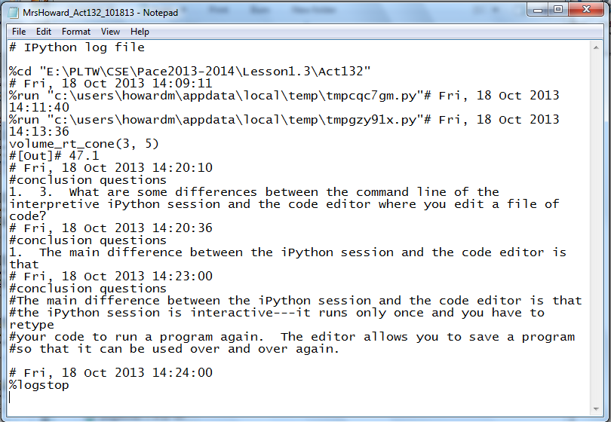
Sample Log File
Here is what my log file looks like.

Slide 14
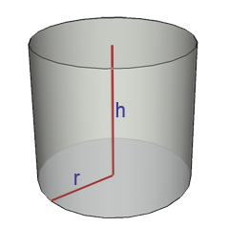
You try it!
Create a new Python program that will calculate the surface area of a Cylinder:
Start logging your session
Write program & test it & save it
End your logging session
Submit to Mrs. Howard the Python program (*.py) and your log (*.log)

